Slide 1

UnitFit Application Architecture Type: Application Architecture View: Logical View Style: Layered Architecture Pattern
Users
Deliver Channels
Core Business Processes
Data And Information
Technology Enablers
Messenger Plug in
Build profile
Mobile
User Data
User Account
Email
Listing Data
Searching
E-payment
Desktop
Saving Data
Users
Listing

Slide 2






UnitFit Application
Architecture Type: Application Architecture
View: Process View
Style: Client-Server Architecture Pattern
Mobile
Web Server
Application Server
Database Server
Fire wall
Web Application
Applications
Database
Authenticating Users
Desktop
Providing Secure Configuration
Handling Exceptions
Authorizing Users
Validating Input
Auditing and logging activity and transaction
Authenticating and authoring upstream identities
Encrypting and hashing sensitive data

Slide 3


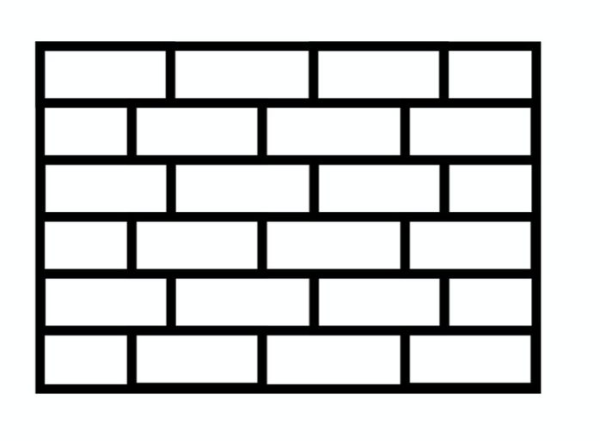






UnitFit Application
Architecture Type: Application Architecture
View: Physical View
Style: Layered Architecture Pattern
Web Application Layer
External layer
Internal Layer
Web server localhost
Firewall Ngnix 1.15
Admin
PC
Load balancer (AWS)
Customers
Firewall Ngnix 1.15
Lenovo Ideapad 330S
Work Station
NetgearC3700N Series Router
CISCO ISR4331-V/K9 Router
user
Cisco ASA 5500-X
DB Instance(Postgres )

